Slide 1
Data Visualisation with R
Richard White

Slide 2
Topics
Data manipulation
tidy data and the pipe (%>%) operator
loading data
selecting, filtering and creating new columns
ggplot2
aesthetics
geoms
shapes and colours
facets
themes

Slide 3
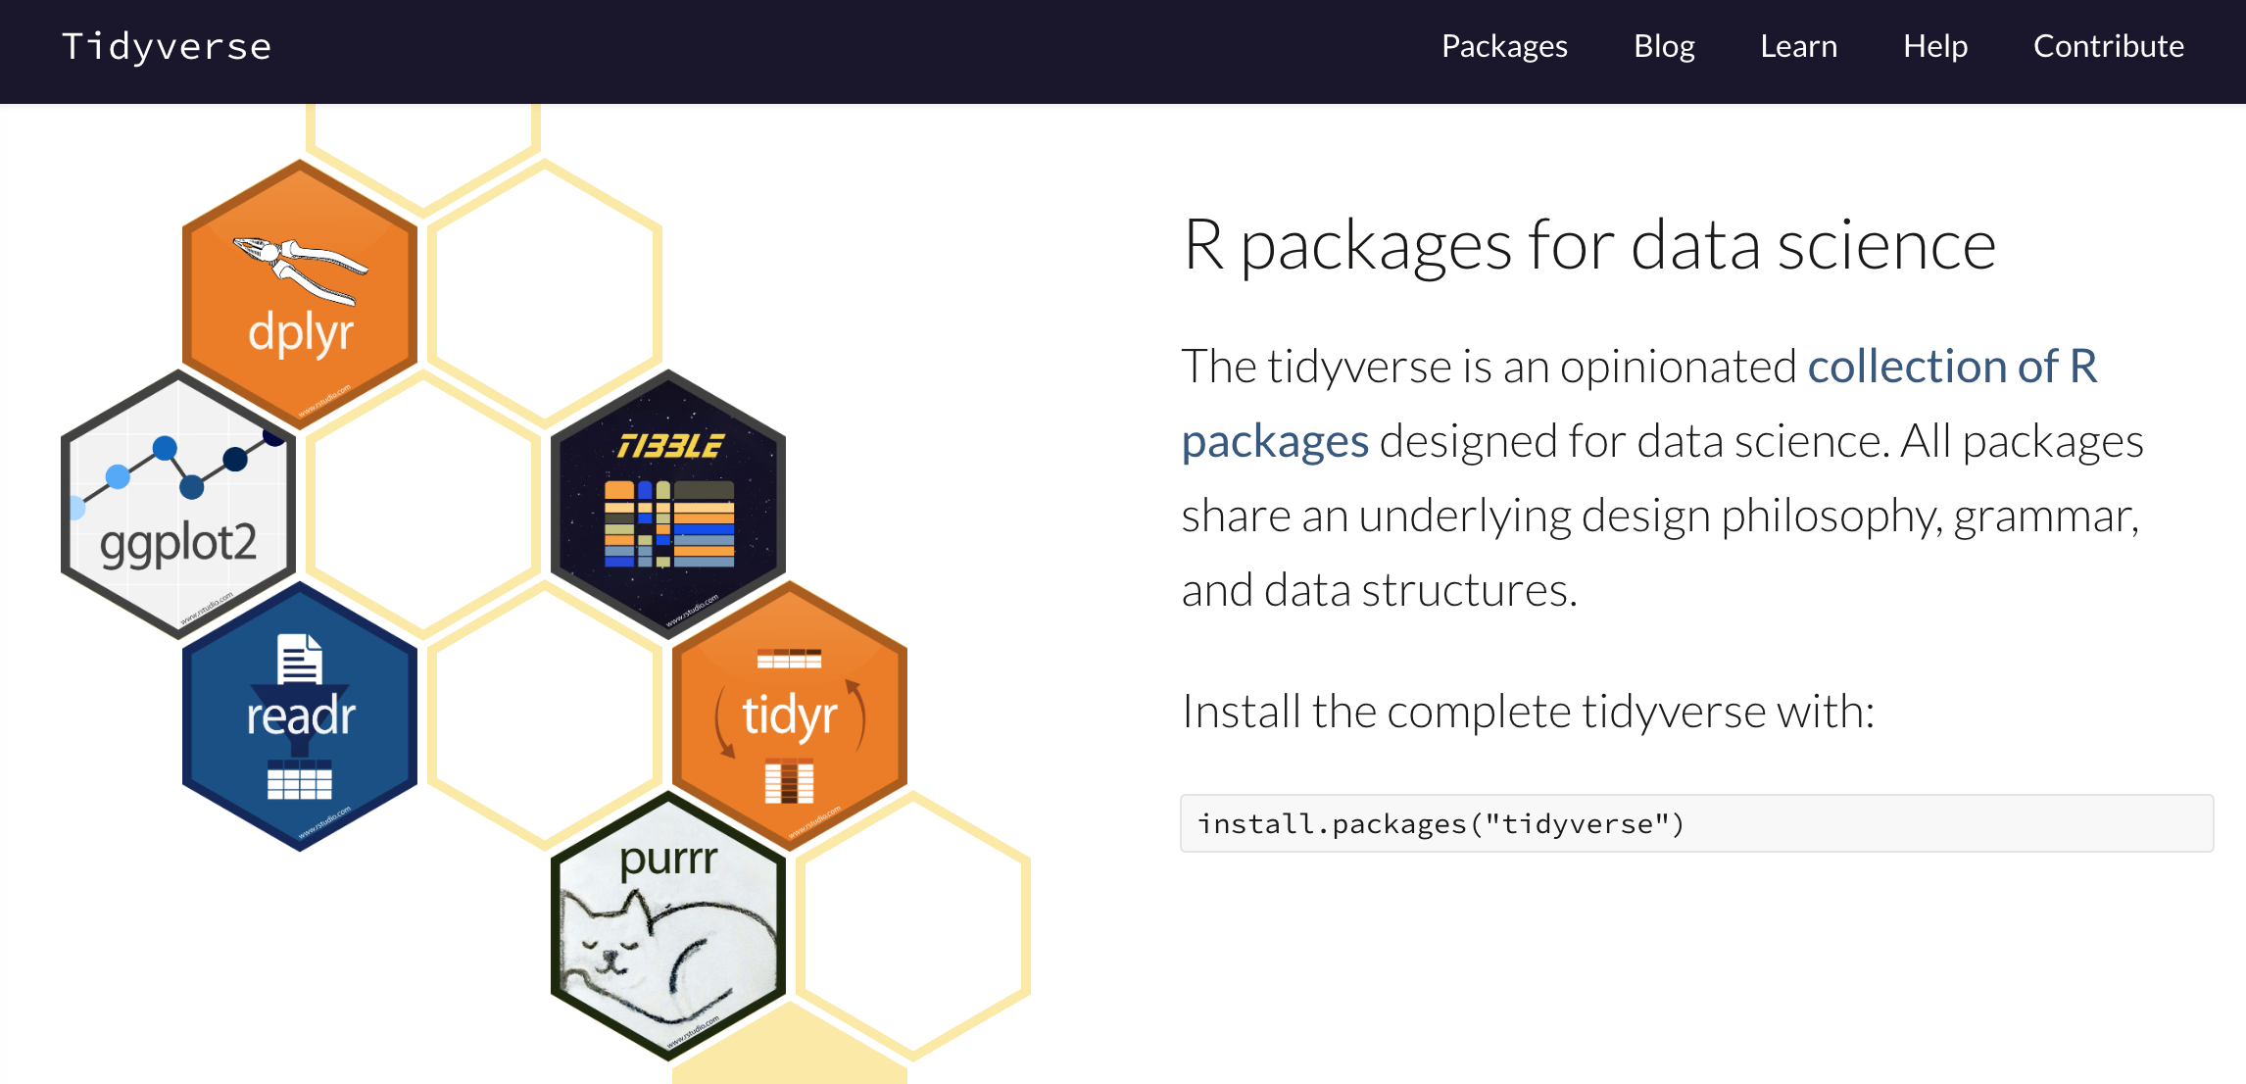
Tidyverse
https://www.tidyverse.org/

Slide 4
Tidy data
Each variable forms a column
Each observation forms a row
Each type of observational unit forms a table
name | description | sample_1 | sample_2 | sample_3
slc35a5 | ENSDARG00000000001 | 36.28229146 | 33.4323 | 34.1081598
ccdc80 | ENSDARG00000000002 | 75.50639034 | 113.155 | 102.324479
nrf1 | ENSDARG00000000018 | 305.9479712 | 281.174 | 274.760176
name | description | sample | normalised_count
slc35a5 | ENSDARG00000000001 | sample_1 | 36.2823
ccdc80 | ENSDARG00000000002 | sample_1 | 75.5064
nrf1 | ENSDARG00000000018 | sample_1 | 305.948
slc35a5 | ENSDARG00000000001 | sample_2 | 33.4323
ccdc80 | ENSDARG00000000002 | sample_2 | 113.155
nrf1 | ENSDARG00000000018 | sample_2 | 281.174
slc35a5 | ENSDARG00000000001 | sample_3 | 34.1082
ccdc80 | ENSDARG00000000002 | sample_3 | 102.324
nrf1 | ENSDARG00000000018 | sample_3 | 274.76

Slide 5
Tidy data
Each variable forms a column
Each observation forms a row
Each type of observational unit forms a table
name | description | sample_1 | sample_2 | sample_3
slc35a5 | ENSDARG00000000001 | 36.28229146 | 33.4323 | 34.1081598
ccdc80 | ENSDARG00000000002 | 75.50639034 | 113.155 | 102.324479
nrf1 | ENSDARG00000000018 | 305.9479712 | 281.174 | 274.760176

Slide 6
Tidy data
Each variable forms a column
Each observation forms a row
Each type of observational unit forms a table
name | description | sample_1 | sample_2 | sample_3
slc35a5 | ENSDARG00000000001 | 36.28229146 | 33.4323 | 34.1081598
ccdc80 | ENSDARG00000000002 | 75.50639034 | 113.155 | 102.324479
nrf1 | ENSDARG00000000018 | 305.9479712 | 281.174 | 274.760176
name | description | sample | count | normalised_count
slc35a5 | ENSDARG00000000001 | sample_1 | 35 | 36.2823
ccdc80 | ENSDARG00000000002 | sample_1 | 75 | 75.5064
nrf1 | ENSDARG00000000018 | sample_1 | 300 | 305.948
slc35a5 | ENSDARG00000000001 | sample_2 | 30 | 33.4323
ccdc80 | ENSDARG00000000002 | sample_2 | 115 | 113.155
nrf1 | ENSDARG00000000018 | sample_2 | 283 | 281.174
slc35a5 | ENSDARG00000000001 | sample_3 | 31 | 34.1082
ccdc80 | ENSDARG00000000002 | sample_3 | 107 | 102.324
nrf1 | ENSDARG00000000018 | sample_3 | 276 | 274.76

Slide 7
pipe
%>%
Equivalent of the Unix |
cut –f1,2,4 data.txt | head
select(data, c(1,2,4)) %>% head()
Allows sending the results of one function into the next
Makes code easier to read
head(select(data, c(1,2,4)), 6)
select(data, c(1,2,4)) %>% head(6)

Slide 8
%>%
eat(
slice(
bake(
put(
pour(
mix(ingredients),
into=baking_form),
into=oven),
time=30),
pieces=6),
1)
ingredients %>%
mix() %>%
pour(into=baking_form) %>%
put(into=oven) %>%
bake(time=30) %>%
slice(pieces=6) %>%
eat(1)
from @dmi3k on Twitter

Slide 9

readr
read_tsv
reads in tab-delimited data and tries to guess the type of each column
character, integer etc.
read_csv
same for comma-separated files
https://readr.tidyverse.org/

Slide 10
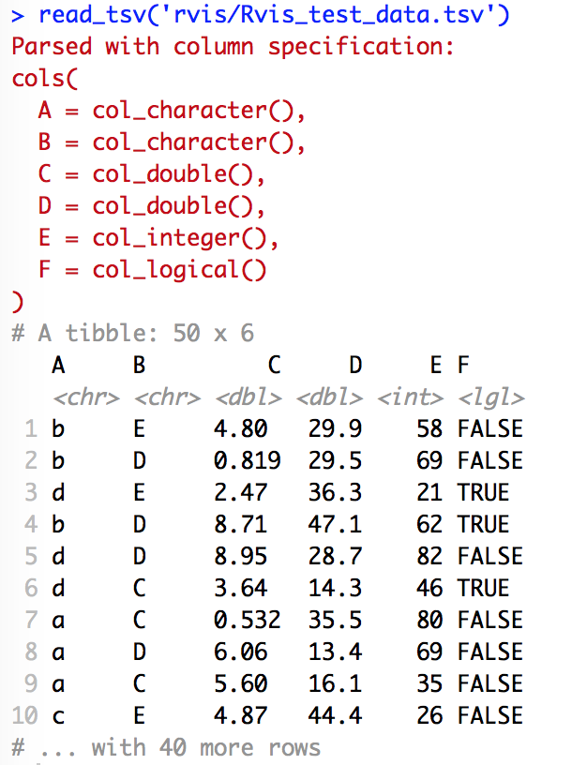
read_tsv

Slide 11
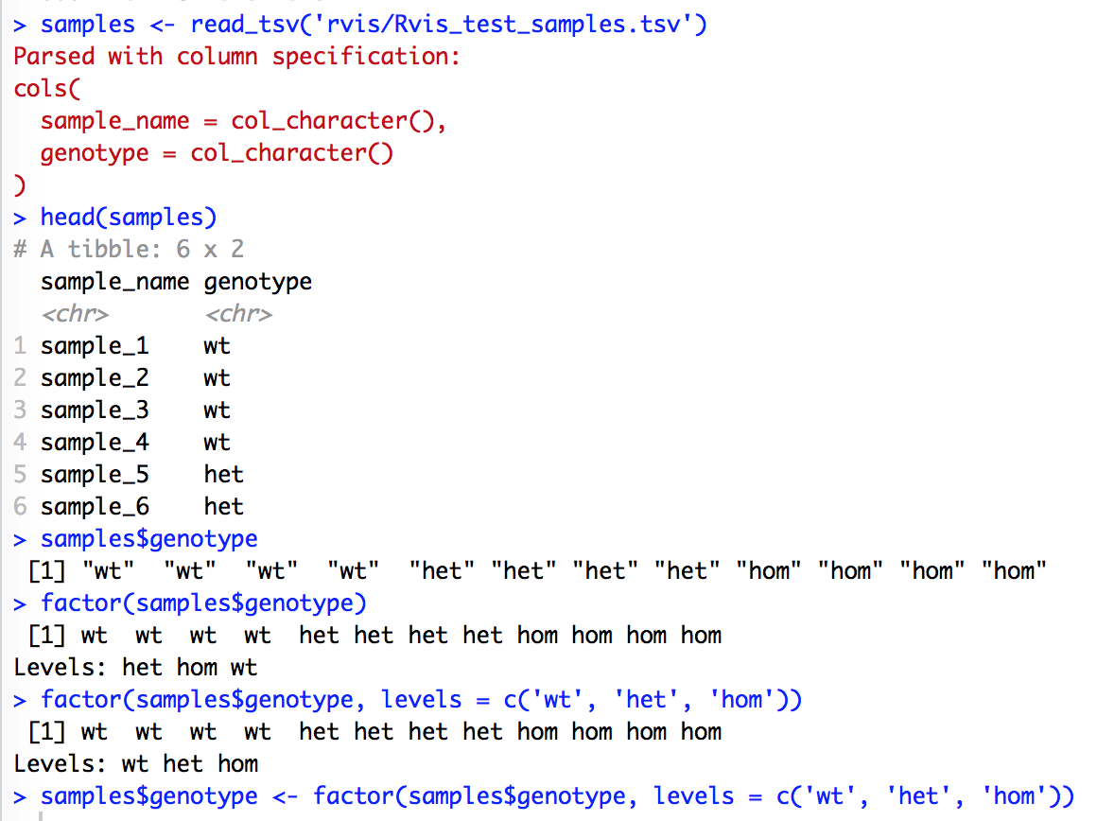
factors

Slide 12
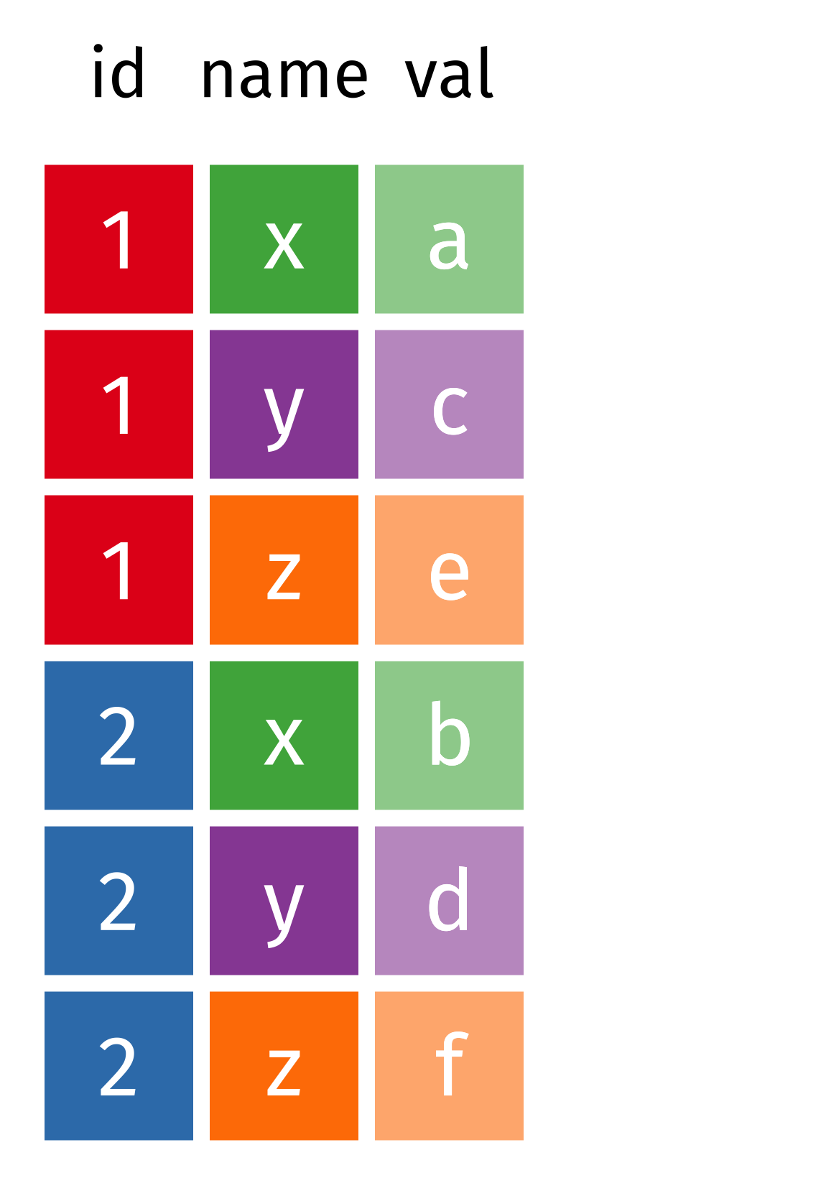
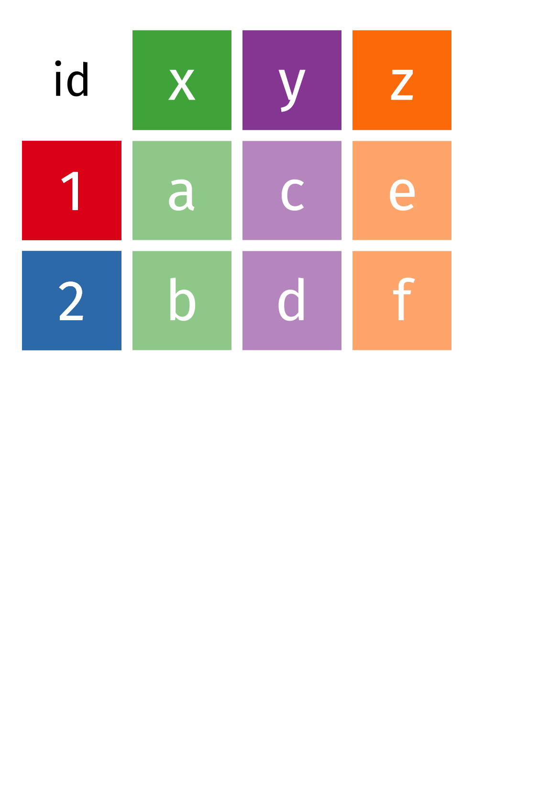
wide vs long data

Slide 13
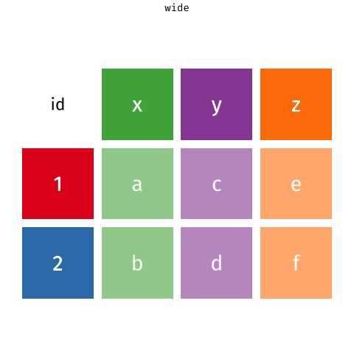
pivot_wider() and pivot_longer()
Garrick Aden-Buie and Mara Averick
https://github.com/batpigandme/tidyexplain/blob/pivot/images/tidyr-longer-wider.gif

Slide 14
Tidy data
name | description | sample_1 | sample_2 | sample_3
slc35a5 | ENSDARG00000000001 | 36.28229146 | 33.4323 | 34.1081598
ccdc80 | ENSDARG00000000002 | 75.50639034 | 113.155 | 102.324479
nrf1 | ENSDARG00000000018 | 305.9479712 | 281.174 | 274.760176
name | description | sample | normalised_count
slc35a5 | ENSDARG00000000001 | sample_1 | 36.2823
ccdc80 | ENSDARG00000000002 | sample_1 | 75.5064
nrf1 | ENSDARG00000000018 | sample_1 | 305.948
slc35a5 | ENSDARG00000000001 | sample_2 | 33.4323
ccdc80 | ENSDARG00000000002 | sample_2 | 113.155
nrf1 | ENSDARG00000000018 | sample_2 | 281.174
slc35a5 | ENSDARG00000000001 | sample_3 | 34.1082
ccdc80 | ENSDARG00000000002 | sample_3 | 102.324
nrf1 | ENSDARG00000000018 | sample_3 | 274.76

Slide 15

Data manipulation
select(): pick variables
filter(): pick rows
mutate(): add new variables that are a function of existing ones
arrange(): sort rows
summarise(): reduce multiple values down to a single summary (mean, min, max, etc.)
https://dplyr.tidyverse.org/index.html

Slide 16
select()
Choose variables from a table
use column names explicitly: select(data, GeneID)
or positions: select(data, c(1,5,9))
column names can be used like they are positions
e.g. select(data, GeneID:Name)
or search functions
starts_with() select(data, starts_with('uninf'))
ends_with() select(data, ends_with('count'))
contains() select(data, contains('3dpf'))
matches() select(data, matches('3dpf.*count'))

Slide 17
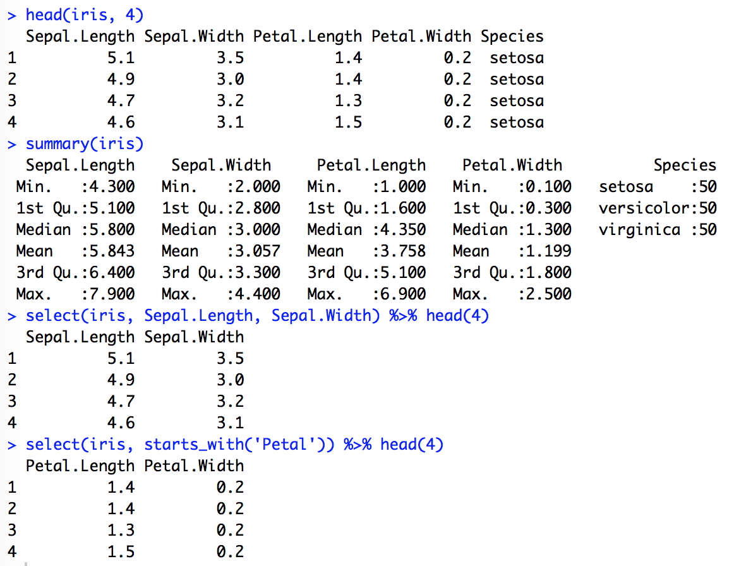
select()

Slide 18
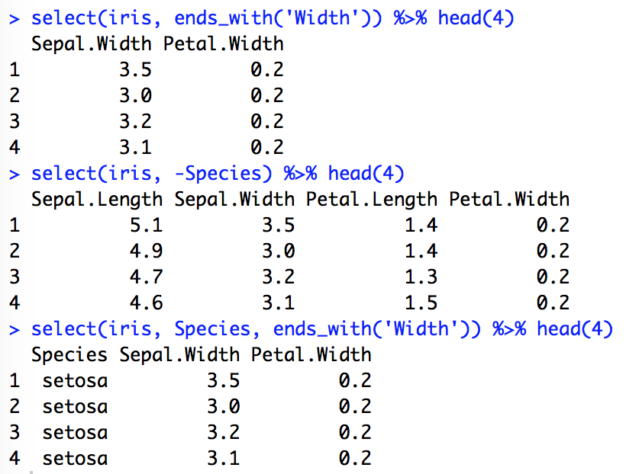
select()

Slide 19
filter()
choose rows where conditions are true
check equality with ==
Also <, >, <=, >=
combine conditions with & (AND), | (OR)
! (NOT)
e.g.
adjustedp < 0.05 & log2fc > 2

Slide 20
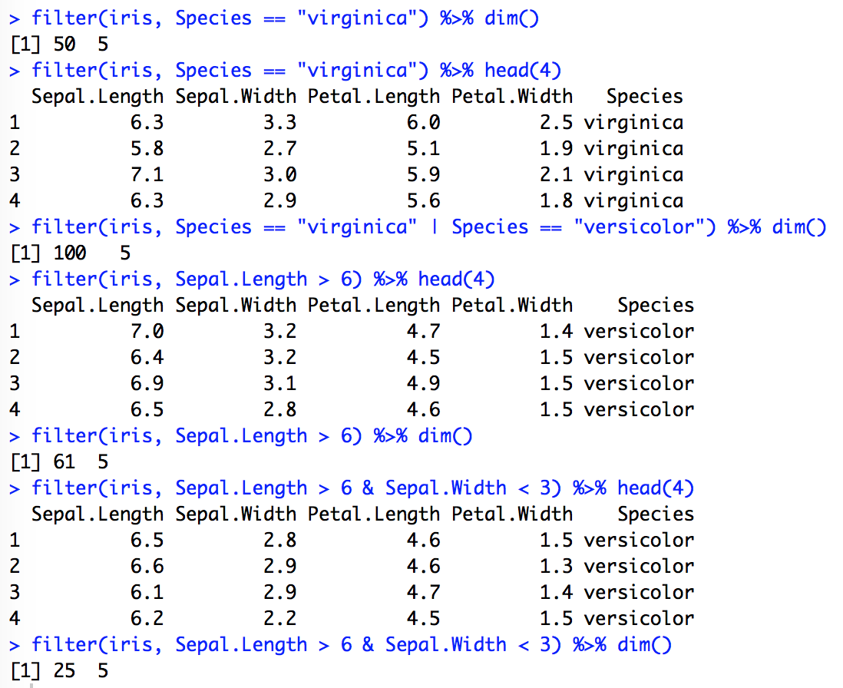
filter()

Slide 21
mutate()
mutate makes new columns that are functions of existing columns
mutate keeps the original column
transmute replaces the original column

Slide 22
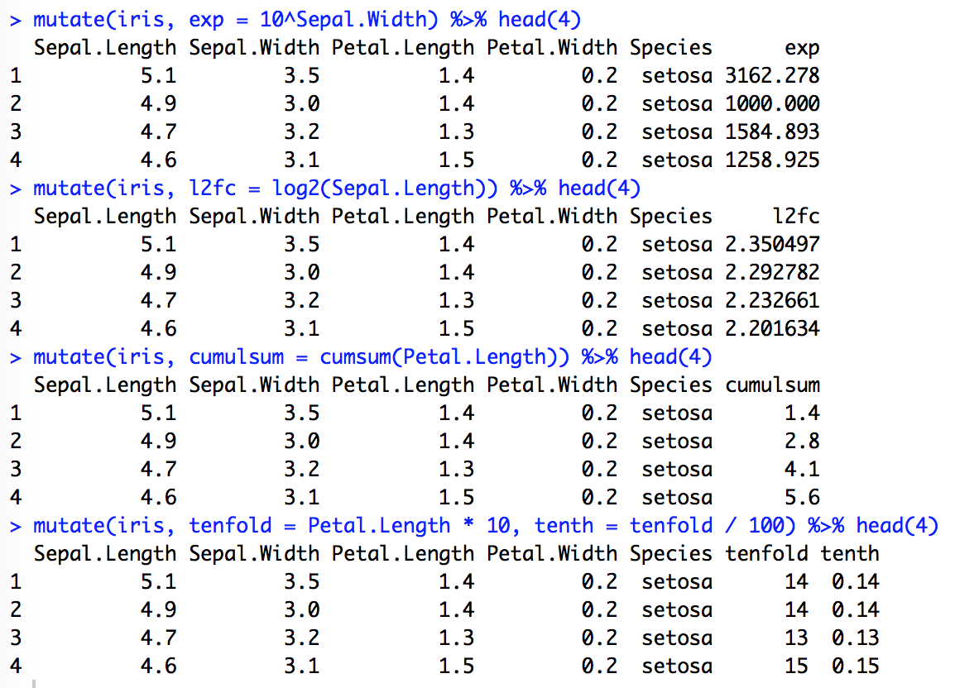
mutate()

Slide 23
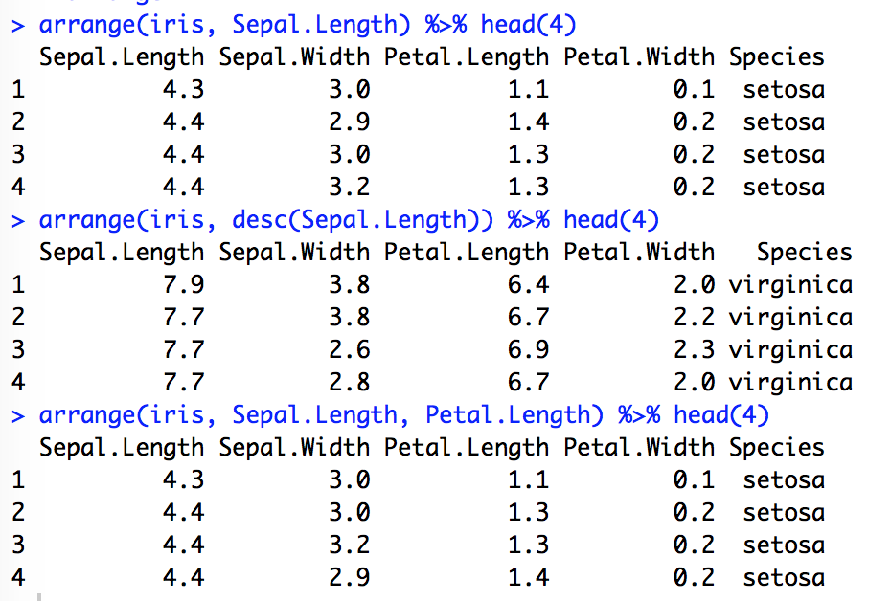
arrange()

Slide 24
Exercises

Slide 25

ggplot2
Grammar of Graphics
Leland Wilkinson (2005)
Components of a plot
data
aesthetics
attributes of a plot that variables in the data are mapped to
x, y, colour, shape, length, size, linetype
theme
https://ggplot2.tidyverse.org/index.html

Slide 26
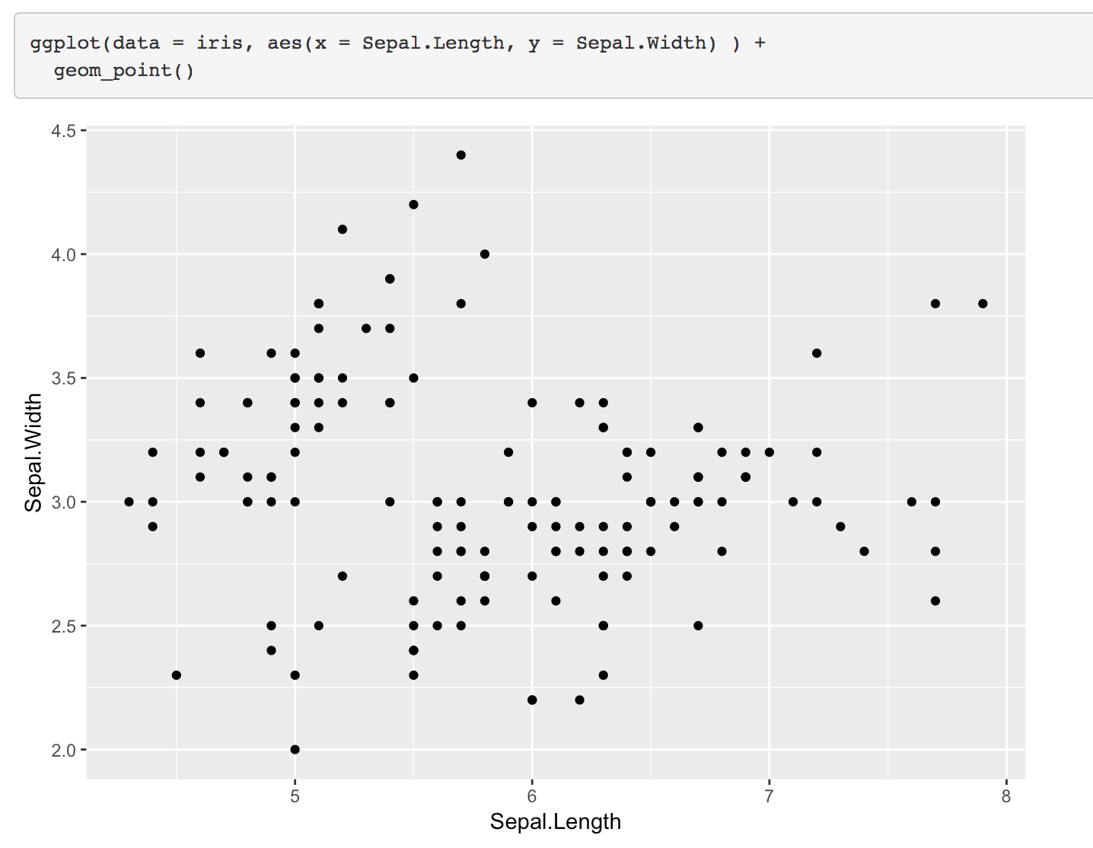
scatterplot

Slide 27
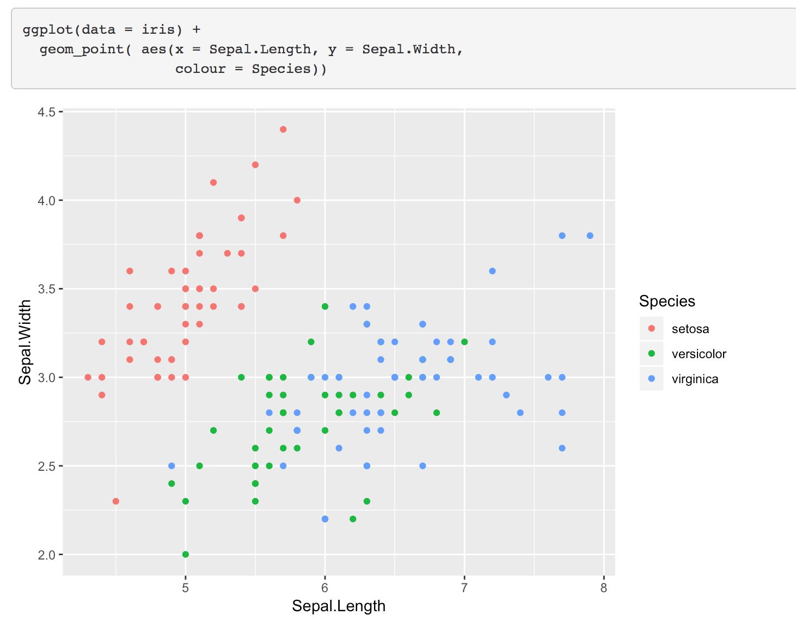
Map categorical variable to colour

Slide 28
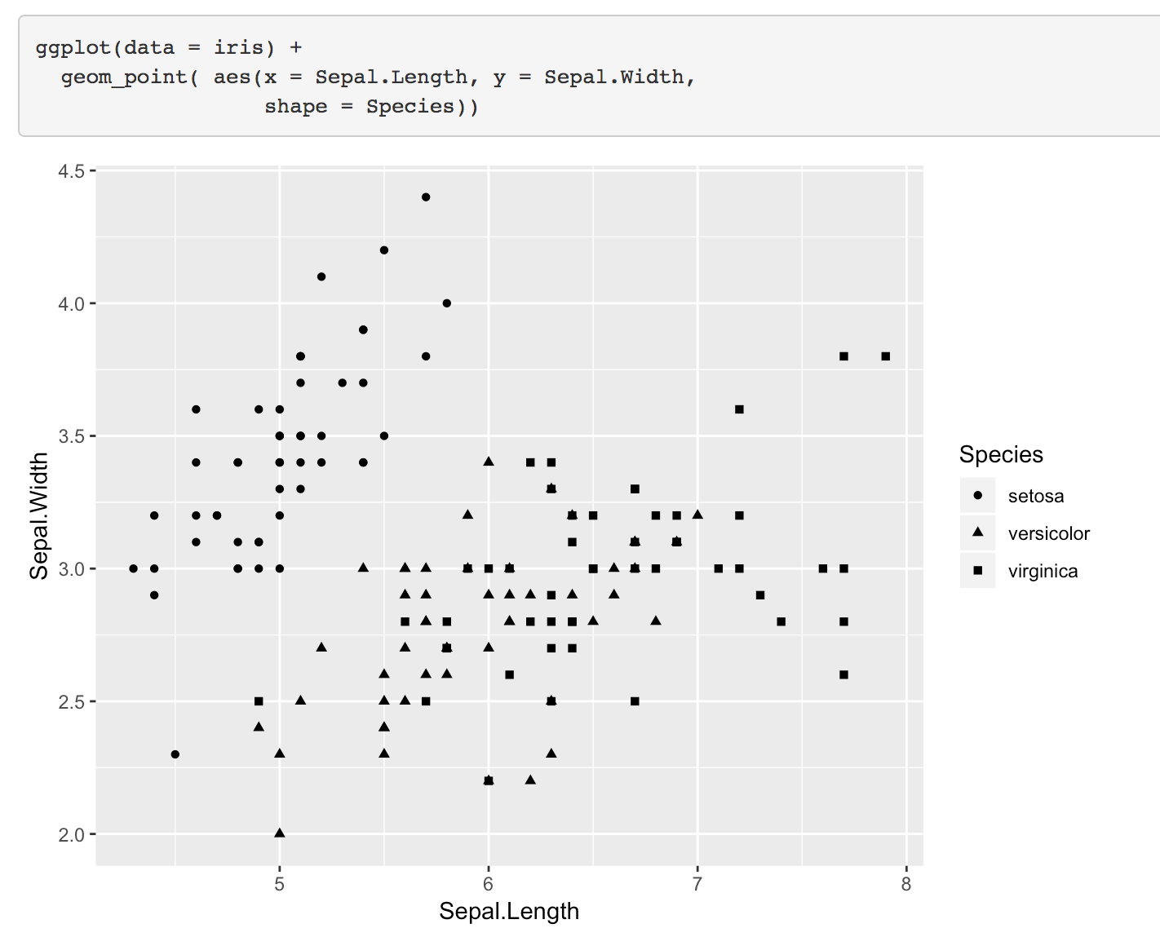
Map categorical variable to shape

Slide 29
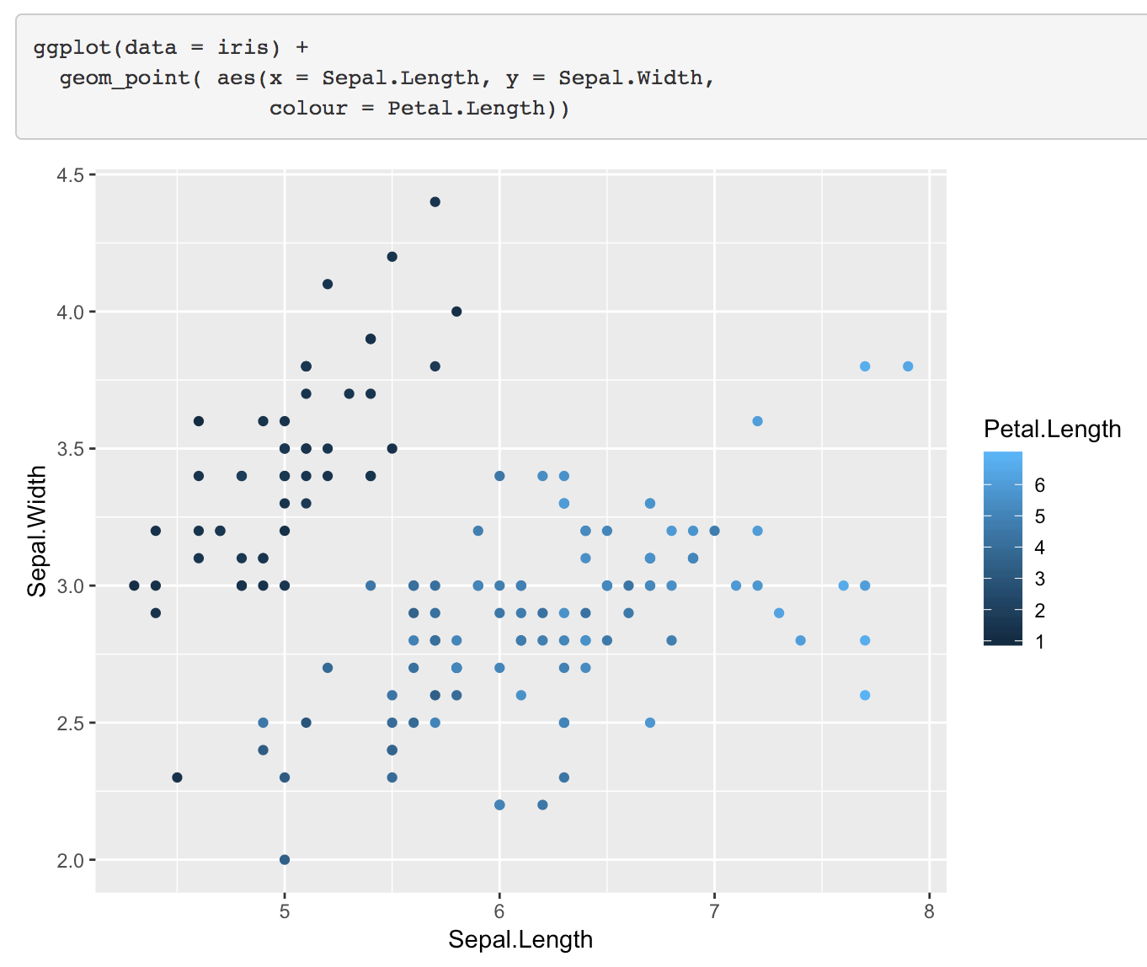
Map continuous variable to colour

Slide 30
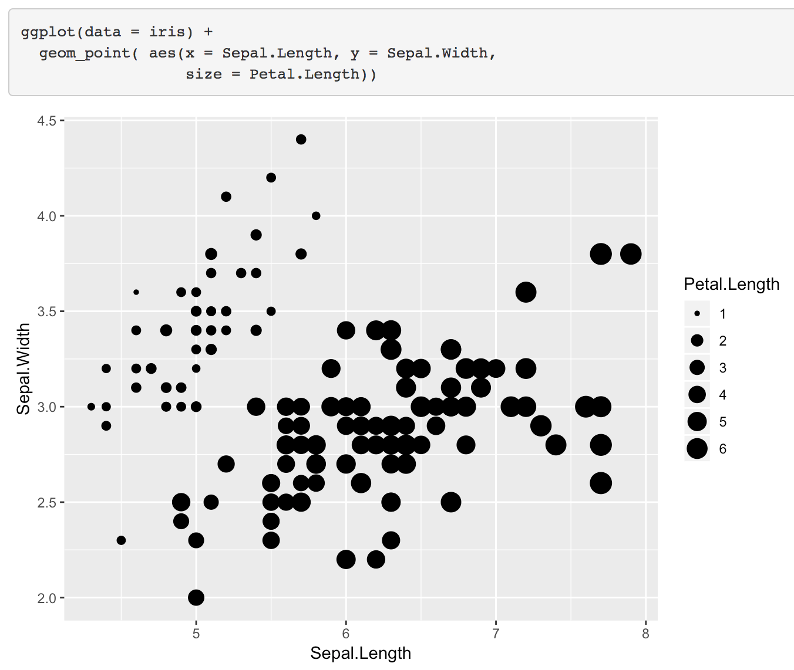
Map continuous variable to size

Slide 31
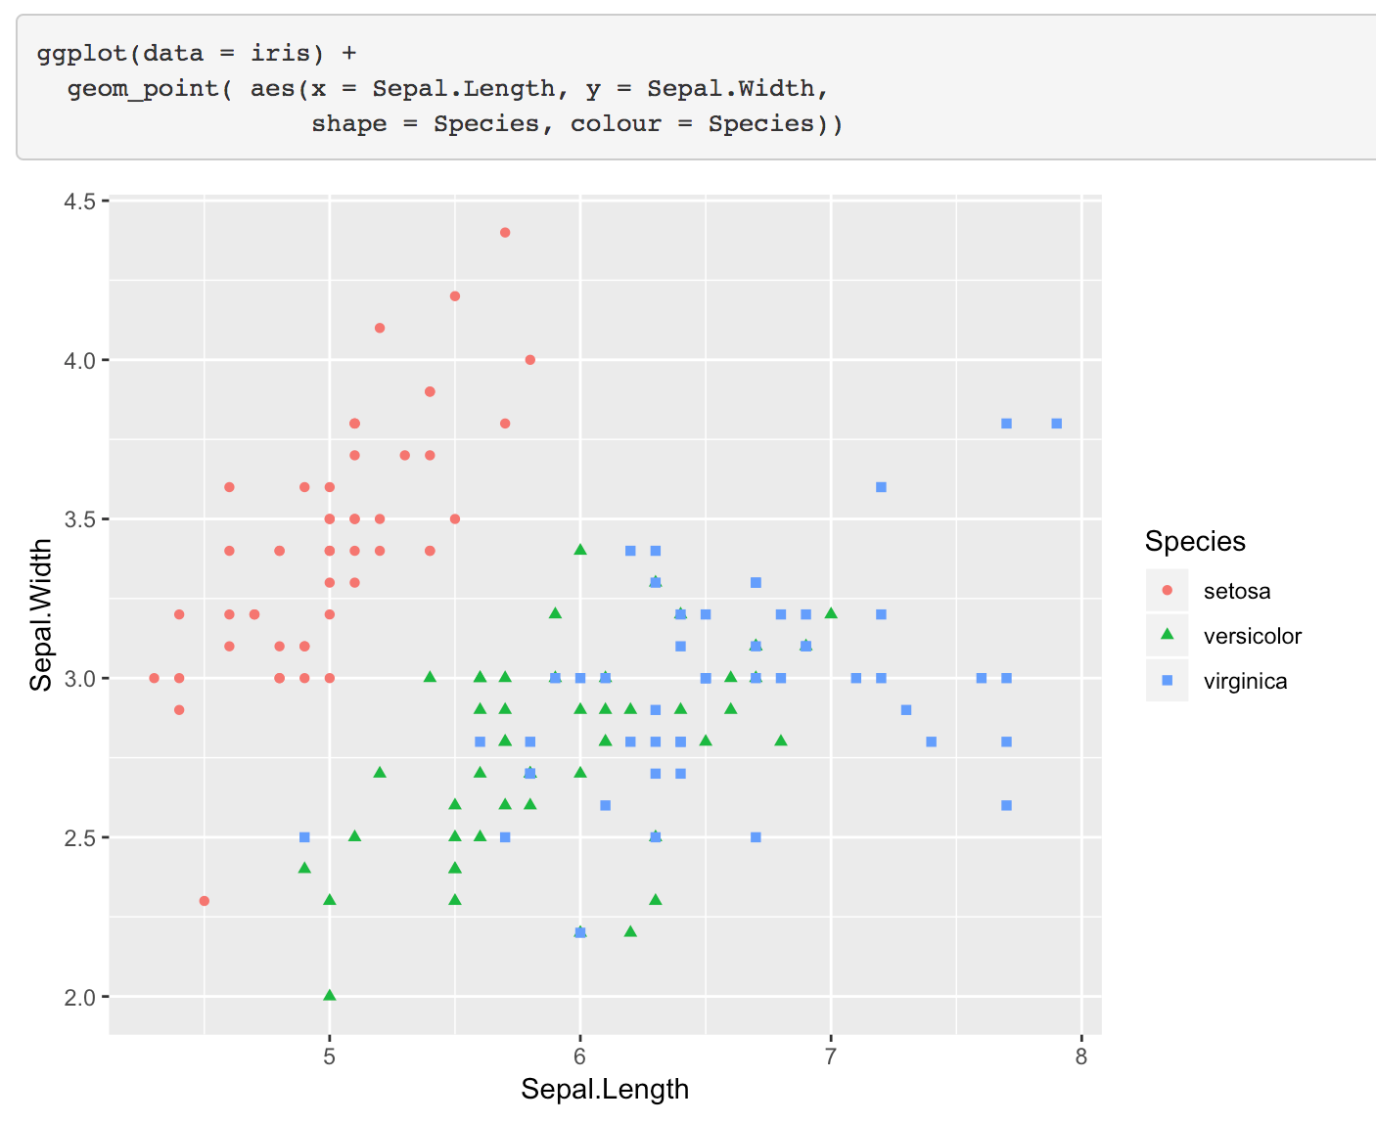
Map variable to colour and shape

Slide 32
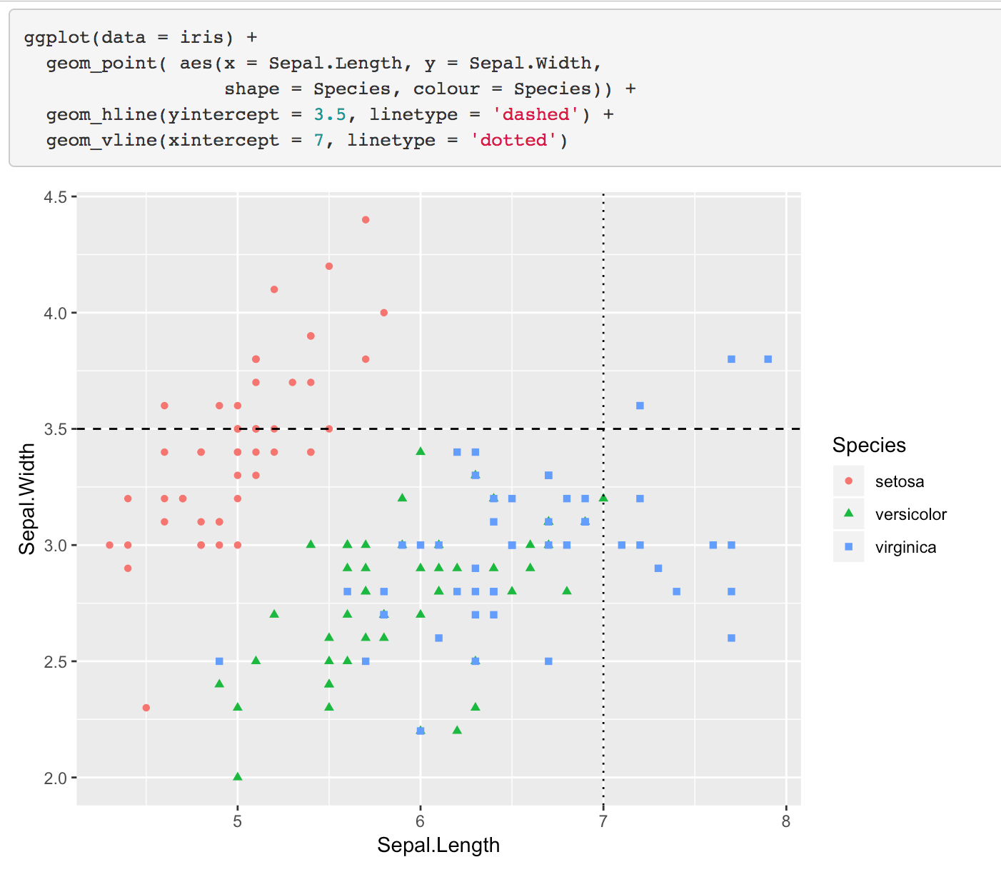
Add extra geoms

Slide 33
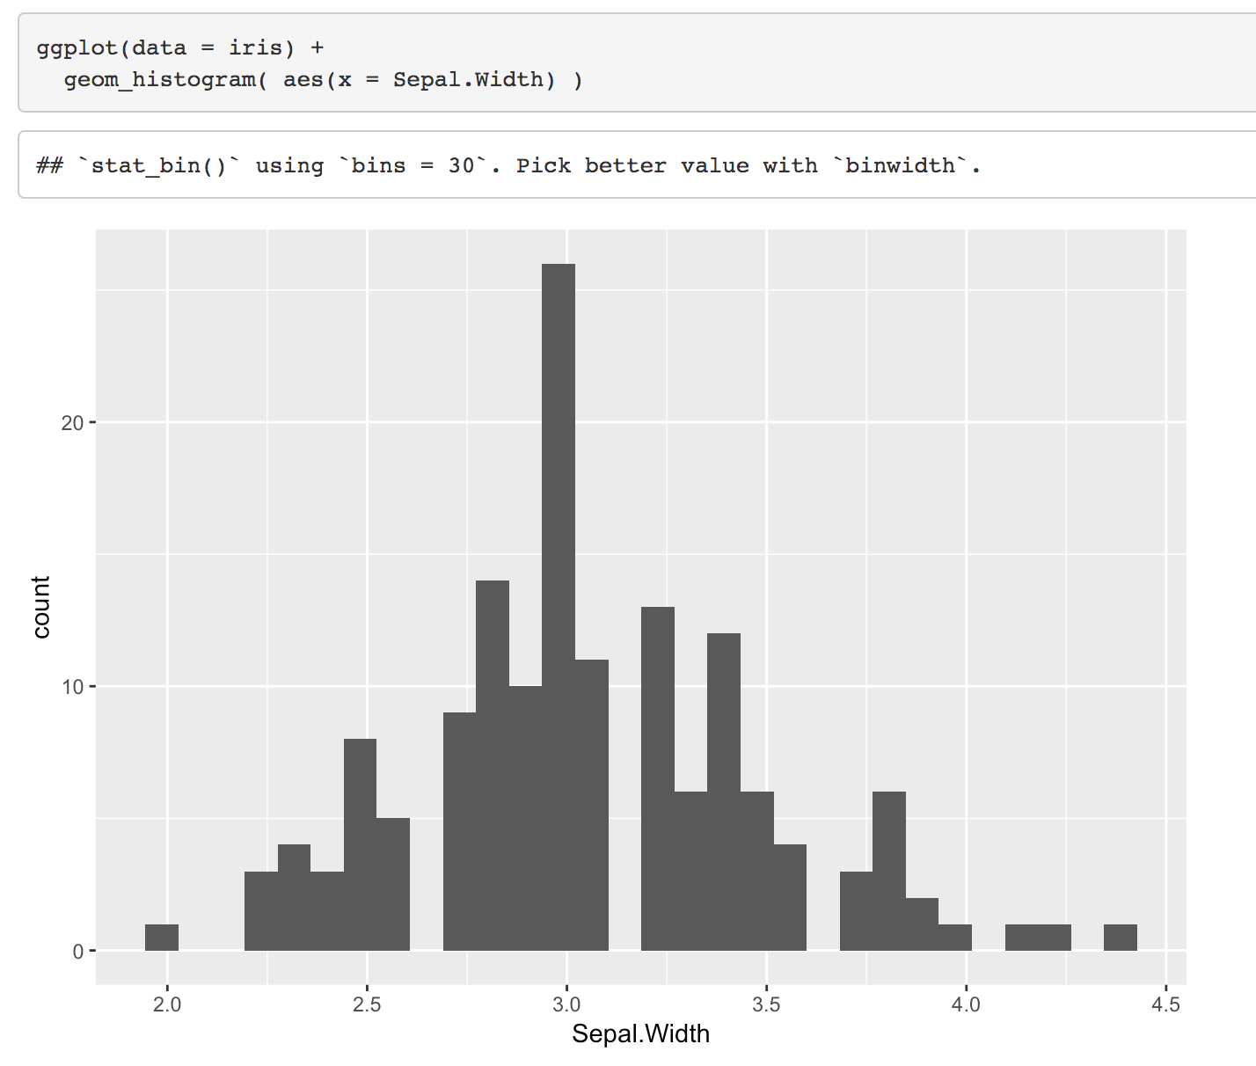
geom_histogram

Slide 34
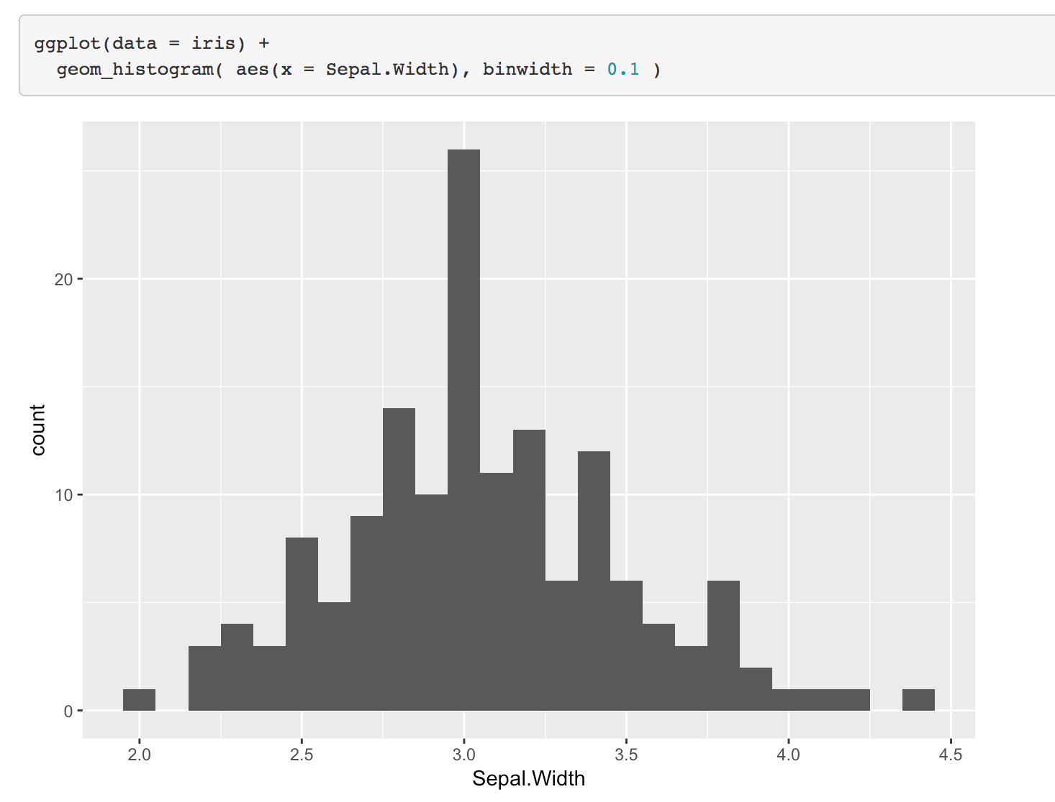
setting the binwidth of a histogram

Slide 35
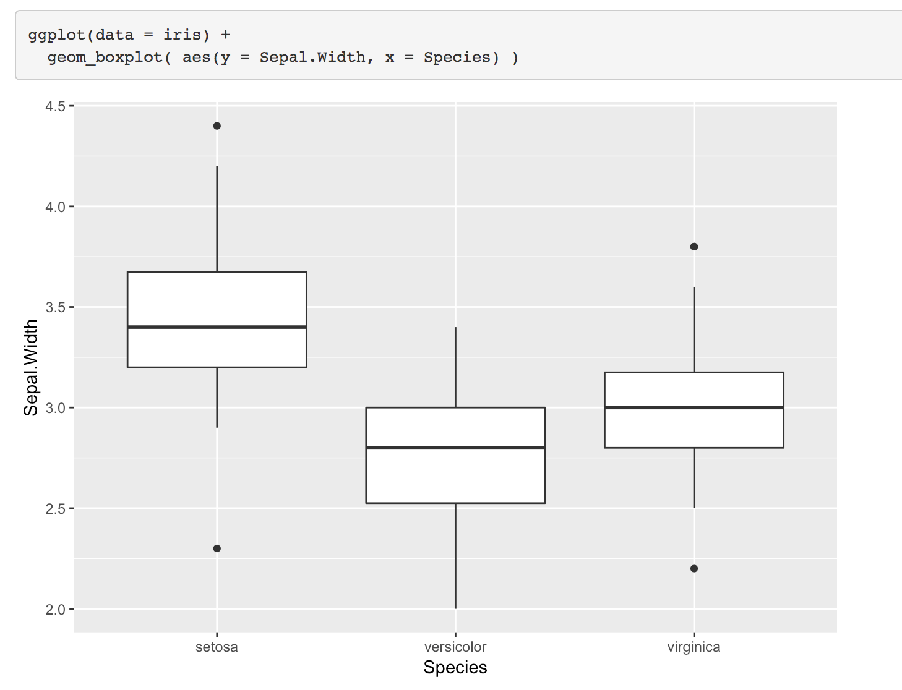
Boxplots

Slide 36
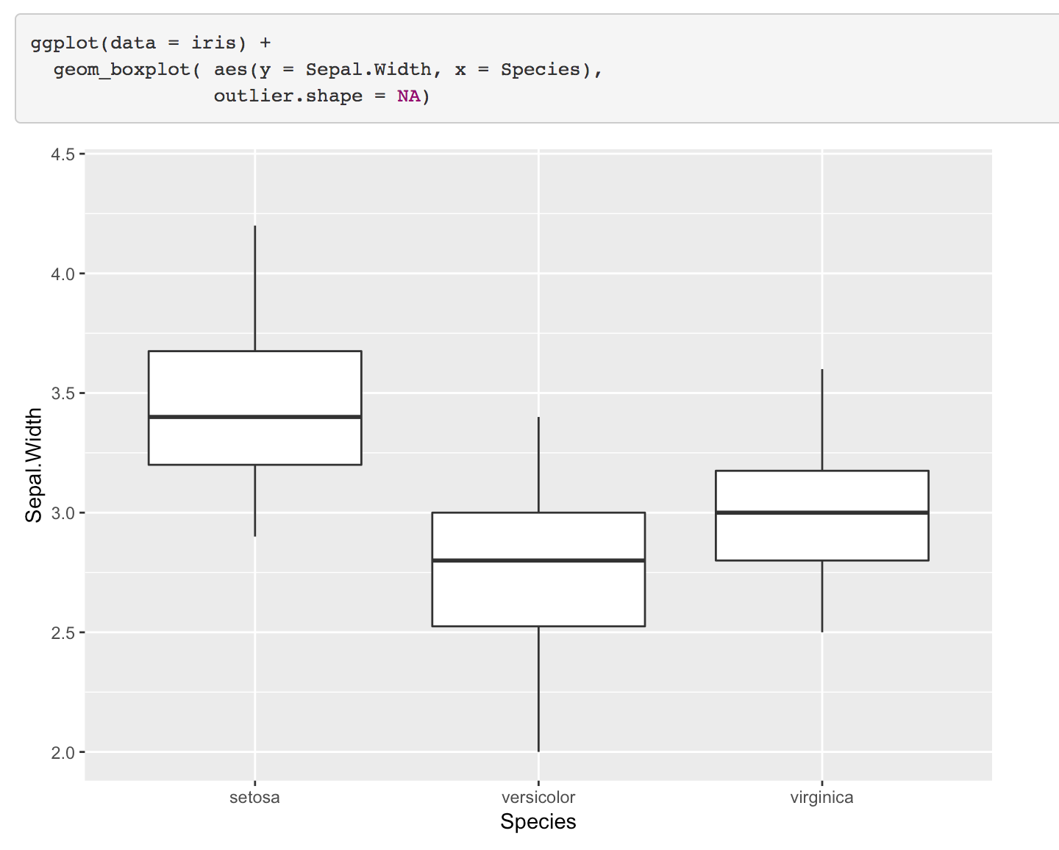
Remove outliers

Slide 37
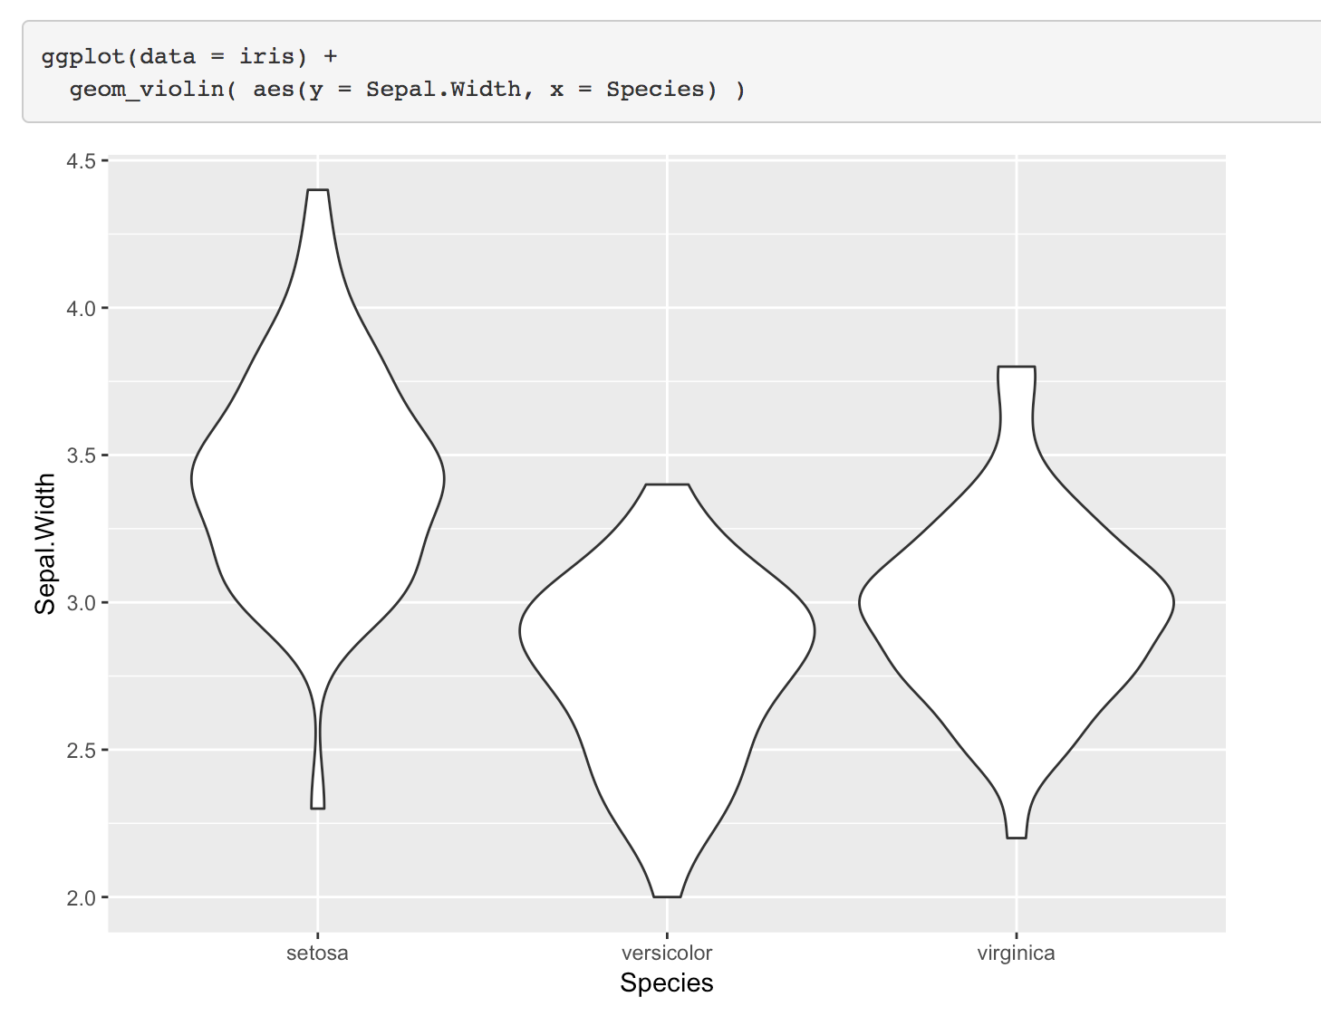
Violin plot

Slide 38
Colours
colours()

Slide 39
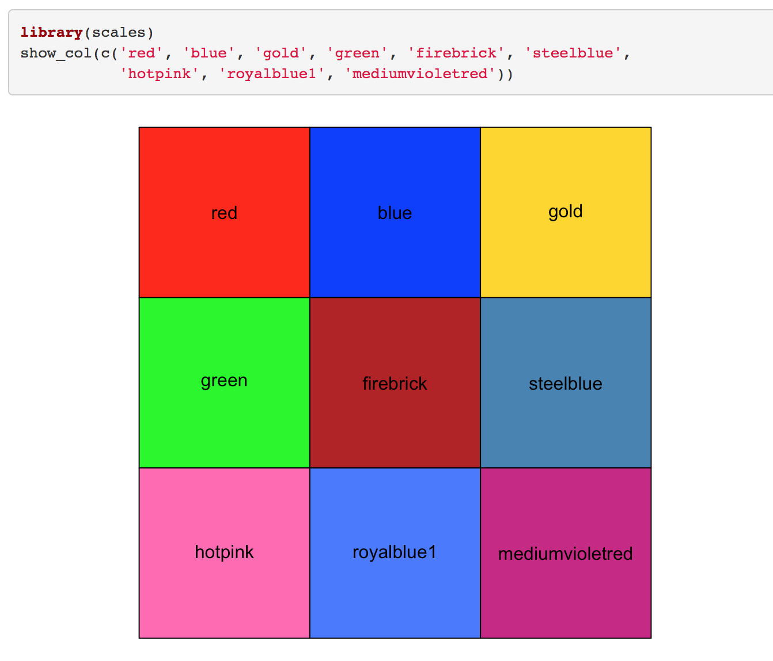
specify colours by name

Slide 40
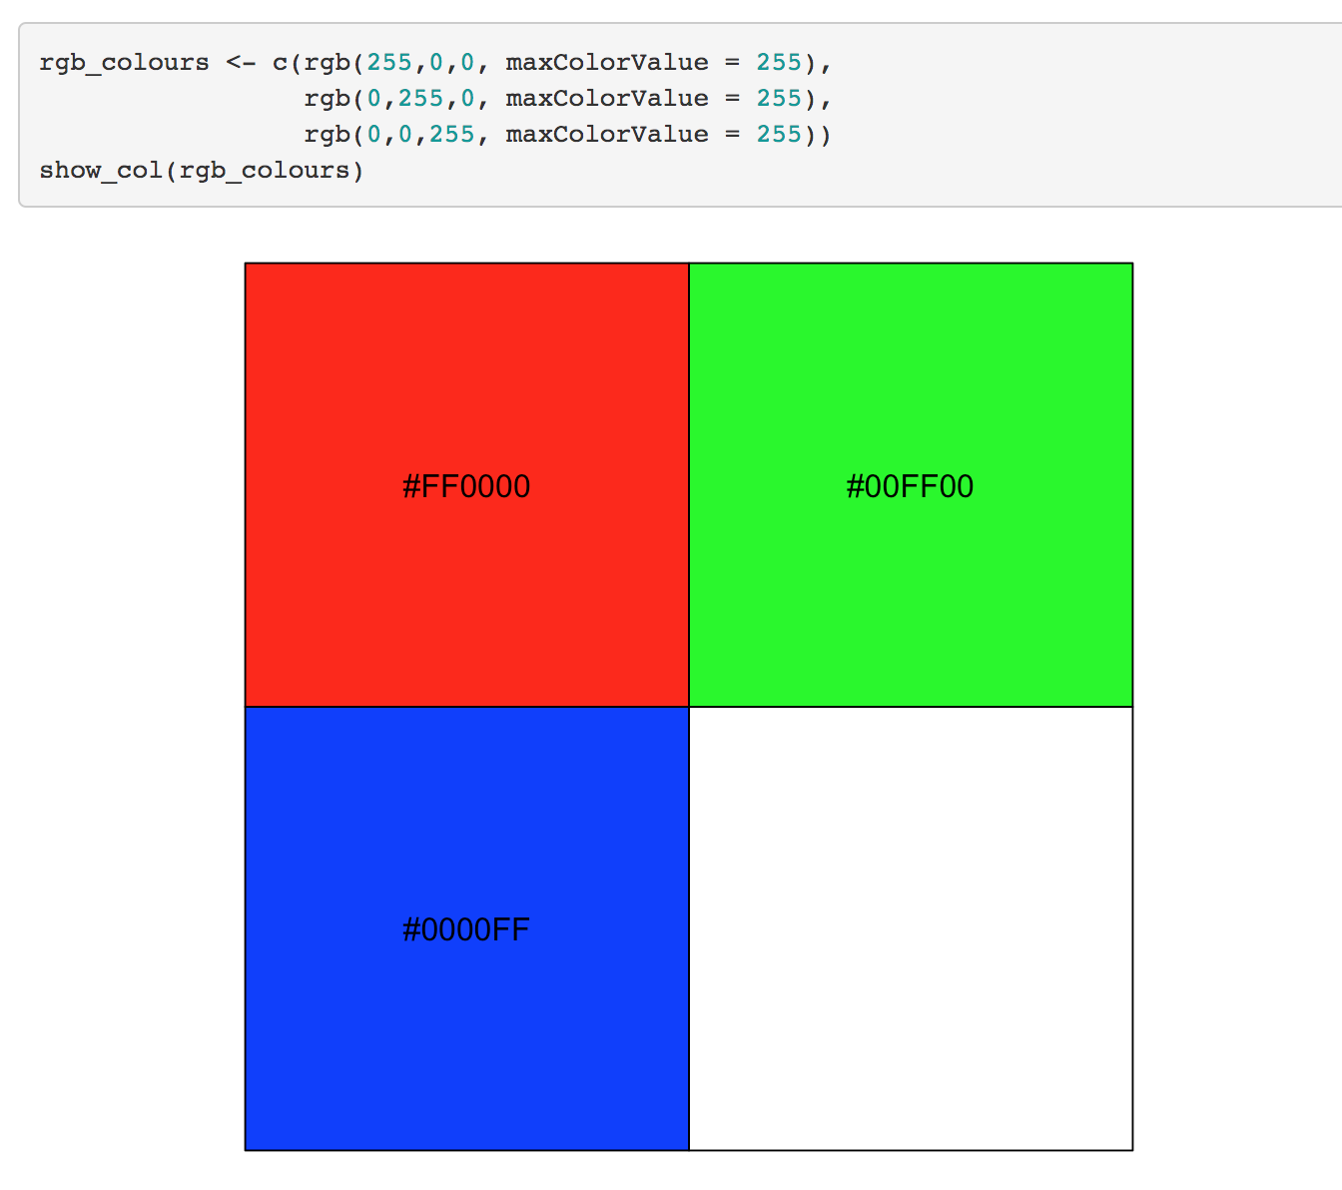
specify colours as RGB values

Slide 41
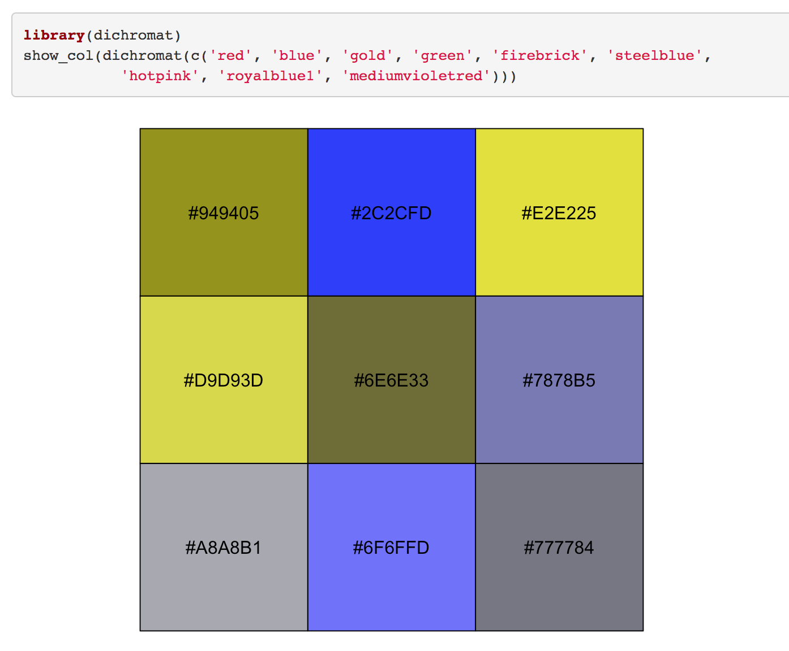
check how colour-blind friendly your palette is

Slide 42
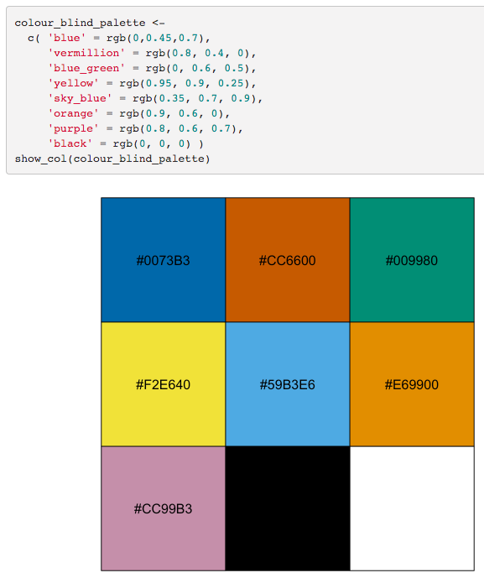
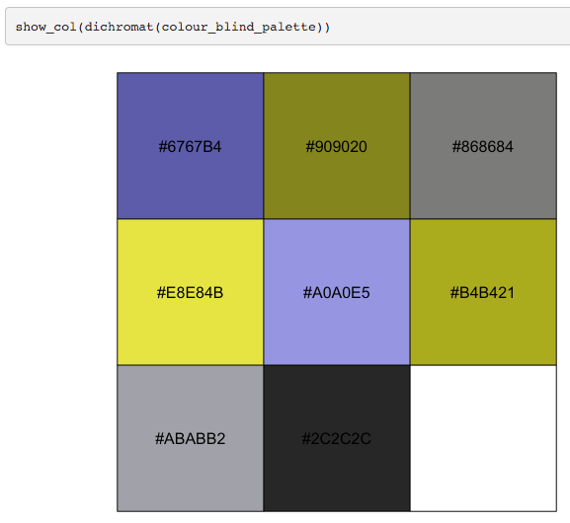
colour-blind friendly palette
https://jfly.uni-koeln.de/color/#pallet
https://doi.org/10.1038/nmeth.1618

Slide 43
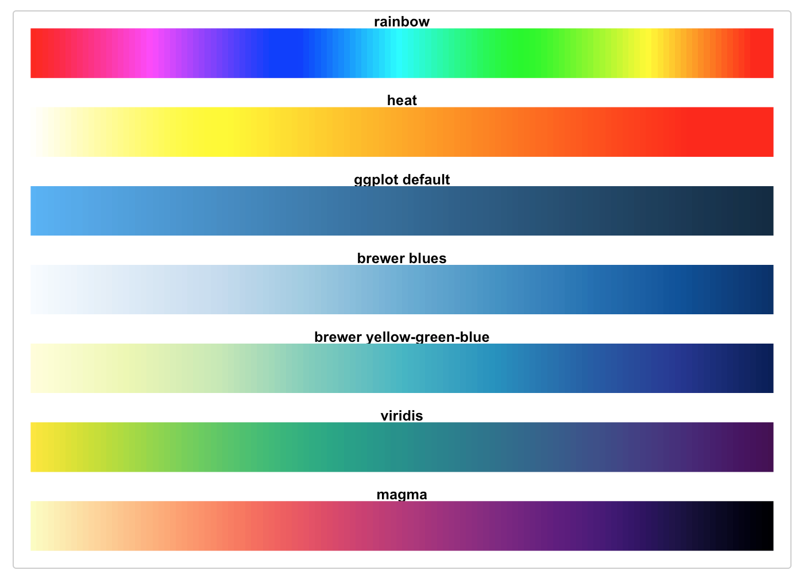
viridis: perceptually uniform colour scales

Slide 44
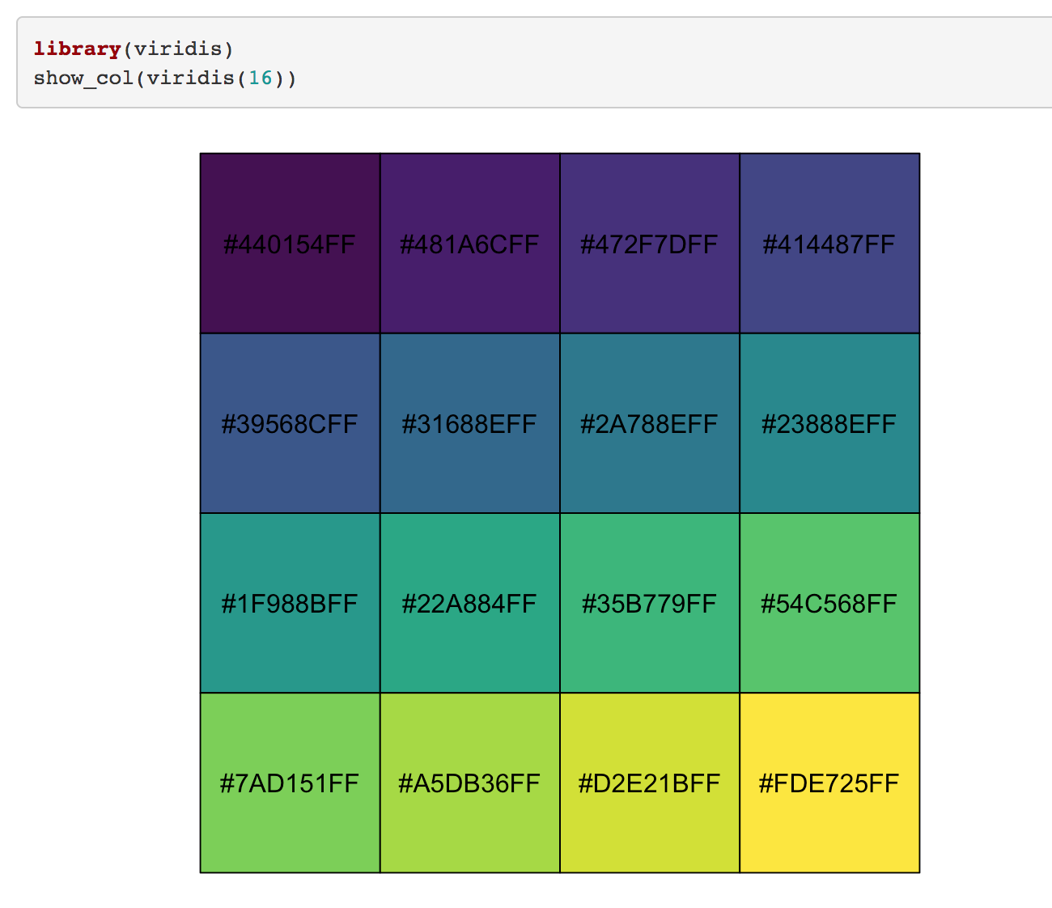
viridis: perceptually uniform colour scales

Slide 45
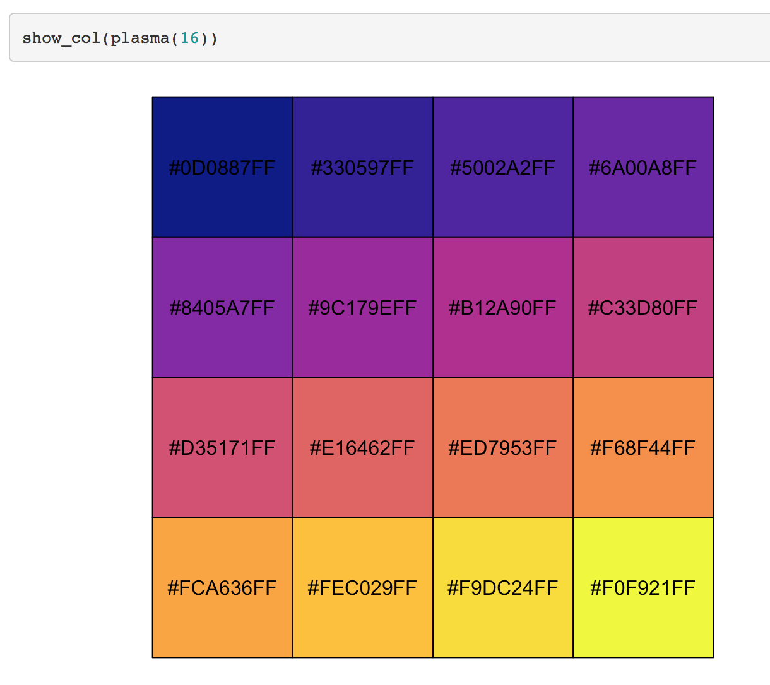
viridis-plasma

Slide 46
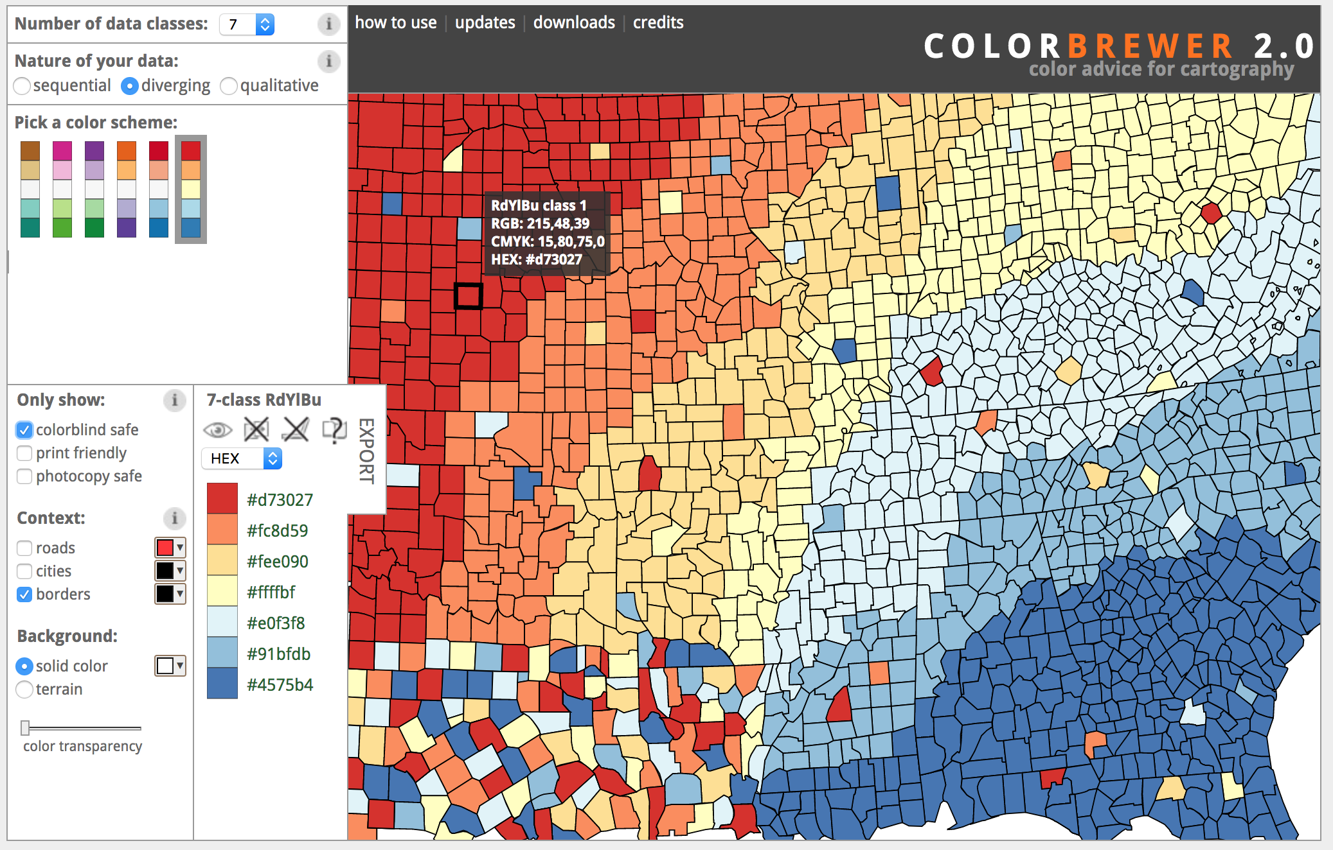
ColorBrewer

Slide 47
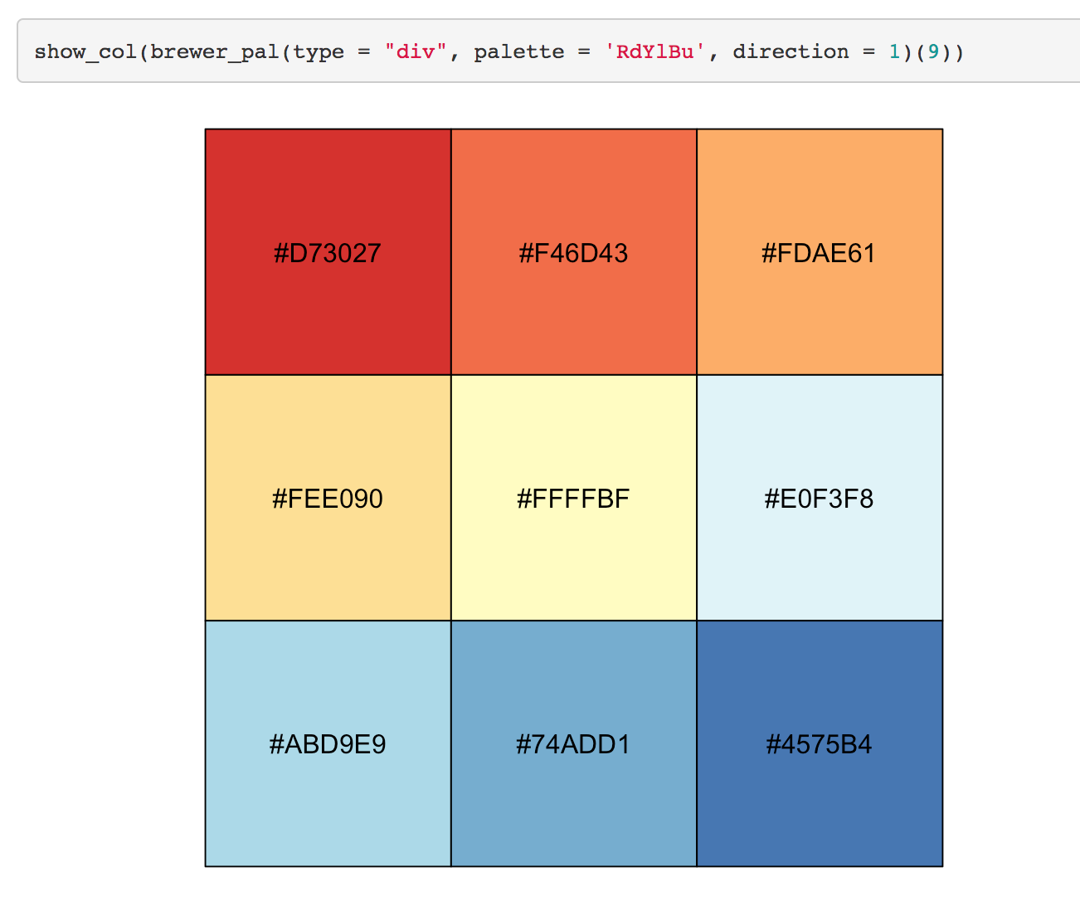
ColorBrewer colour schemes

Slide 48
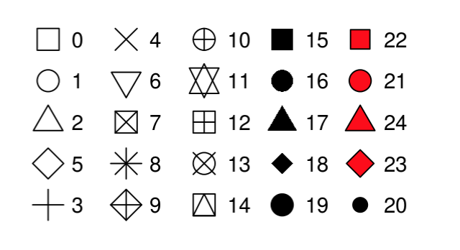
Shapes
There are 25 available shapes for plotting that are identified by numbers
0-14 are hollow. The border colour is determined by the colour aesthetic
15-20 are solid. The colour is determined by the colour aesthetic
21-24 are filled shapes that have a border colour and a fill colour

Slide 49
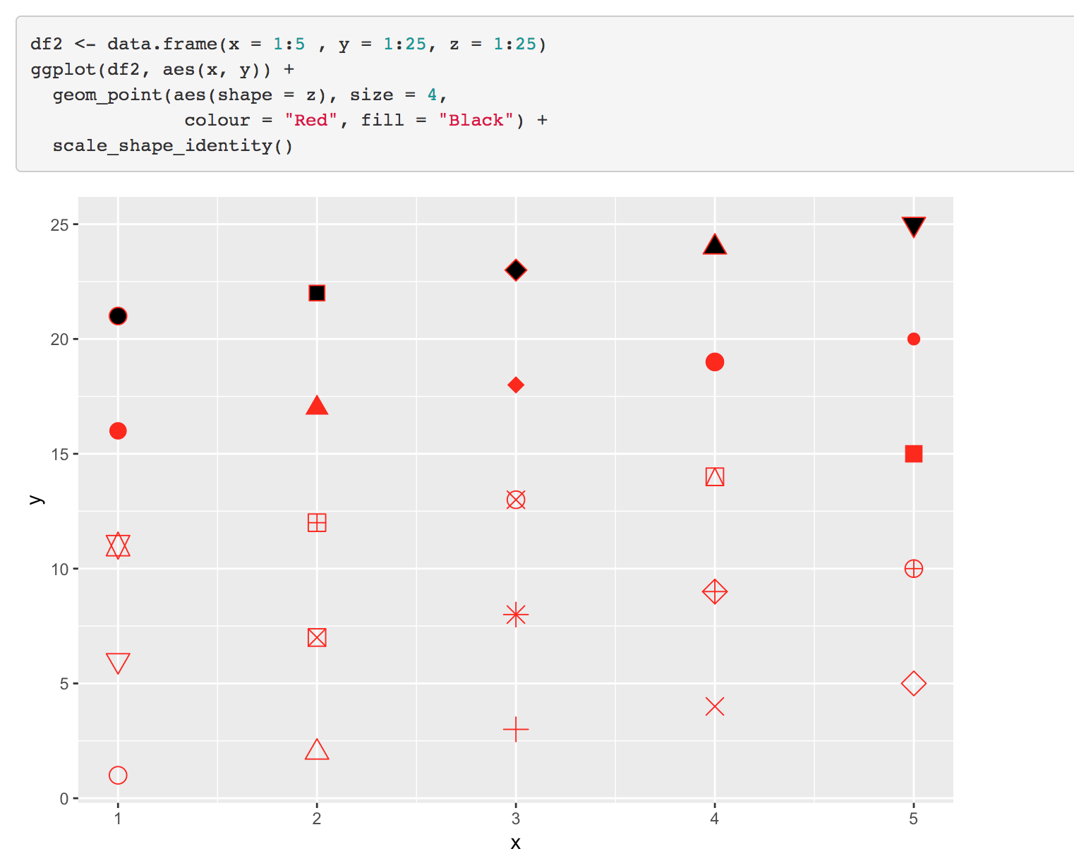
Shapes
https://ggplot2.tidyverse.org/reference/aes_linetype_size_shape.html

Slide 50
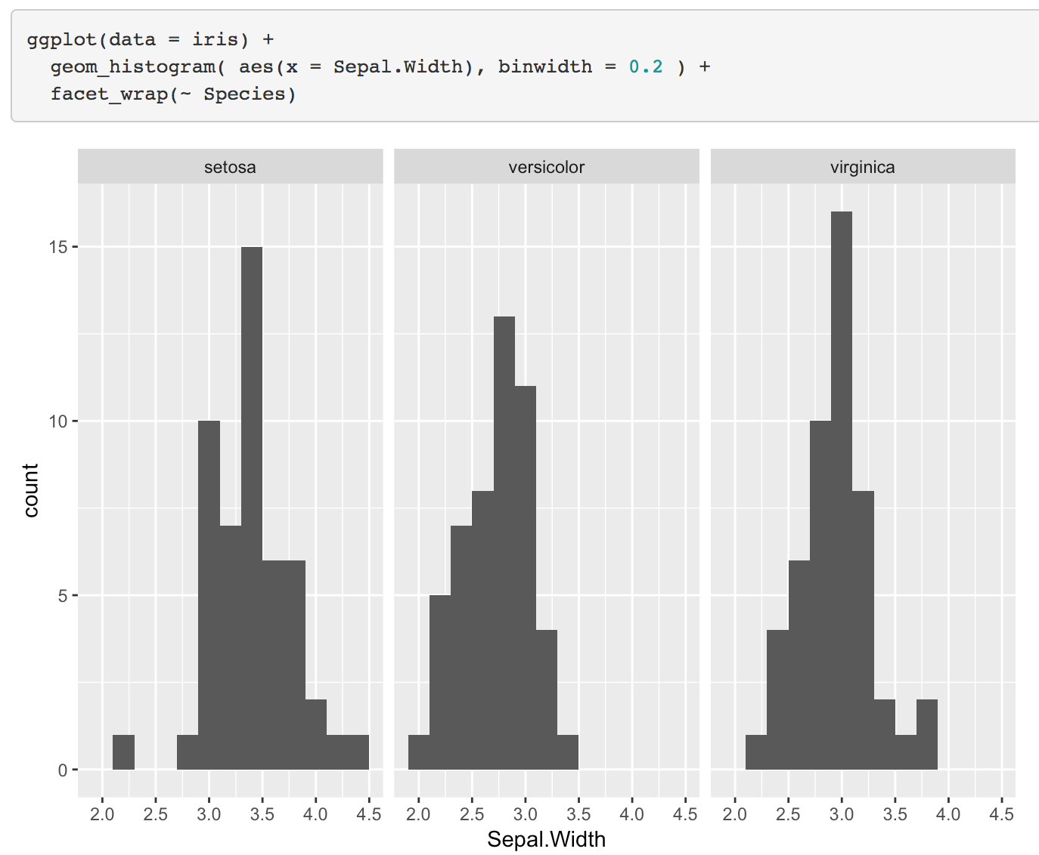
Facets

Slide 51
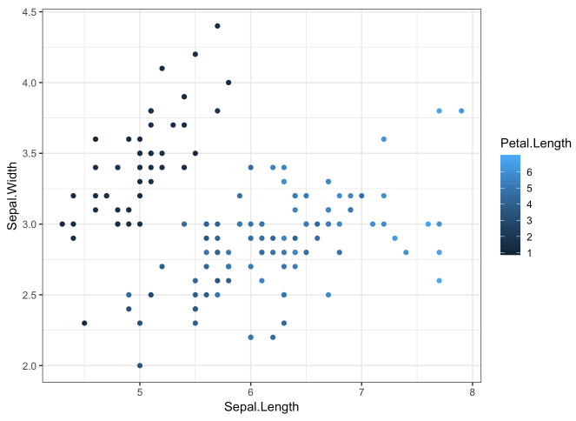
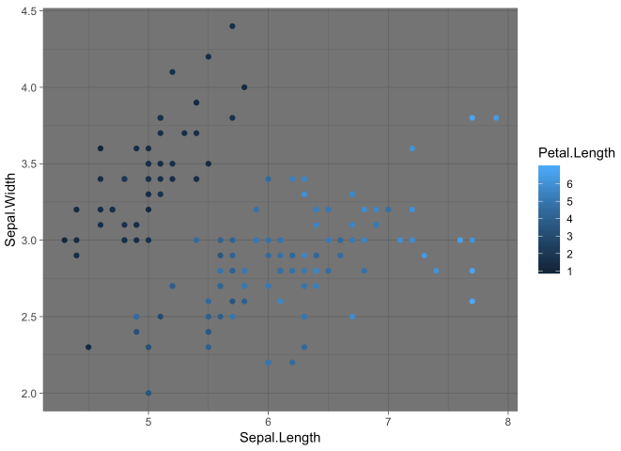
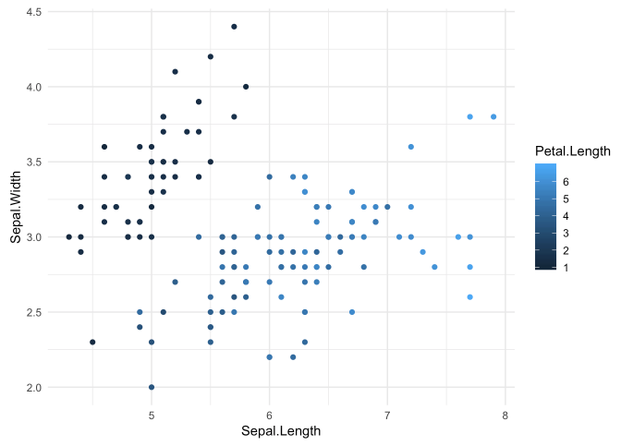
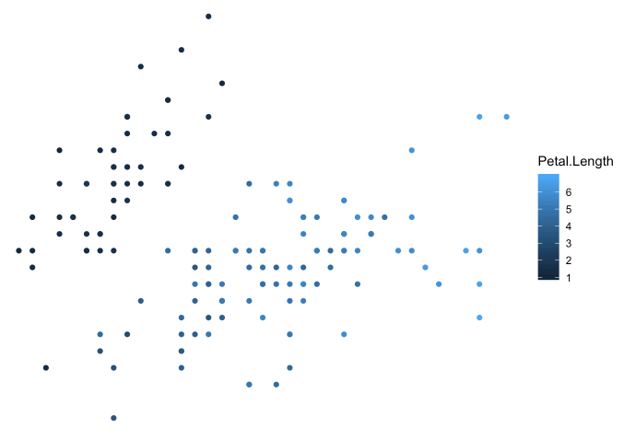
Themes
theme_bw()
theme_dark()
theme_light()
theme_void()

Slide 52
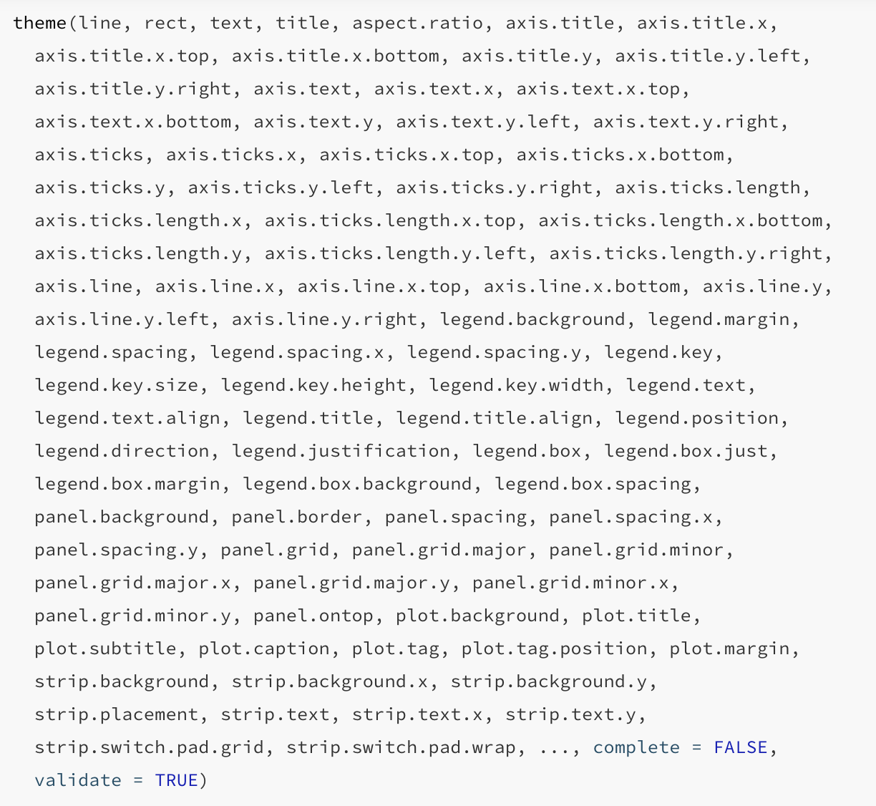
Customising themes
https://ggplot2.tidyverse.org/reference/theme.html

Slide 53
Theme elements
element_text
font_family, colour, size, angle
element_line
colour, size, linetype
element_rect: borders and backgrounds
fill, colour, size, linetype
https://ggplot2.tidyverse.org/reference/element.html

Slide 54
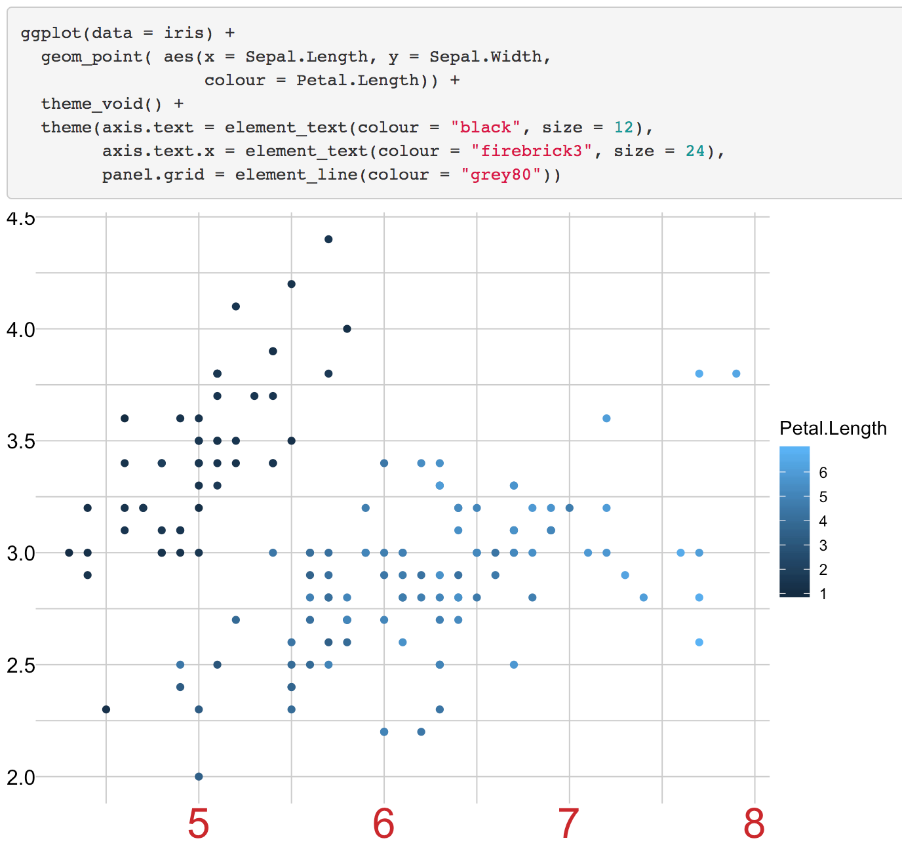
Customising themes

Slide 55
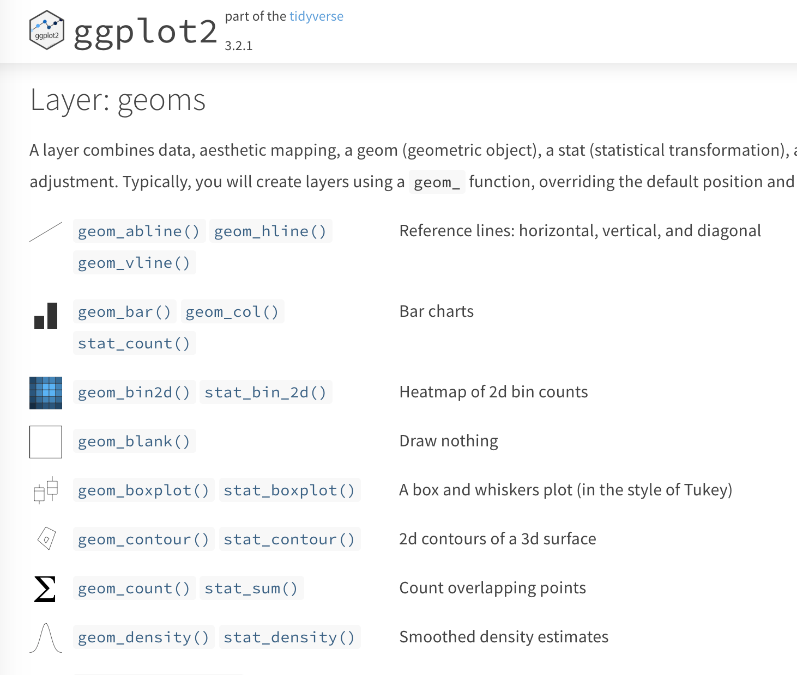
Further Reading
https://ggplot2.tidyverse.org/reference/

Slide 56

Further Reading
https://r4ds.had.co.nz/

Slide 57
Exercises

